Slide 1
Interdisciplinary Morbidity and Mortality Conference
10/14/2021

Slide 2
Morbidity & Mortality Conference Thursday, May 9, 2024
Moderator: Adewale Ajumobi, MD, MBA, FACP, FACG, AGAF, FASGE
Presenters: Nicholas Newell, MD
Learning Objectives:
Analyze the relationship of error to poor medical outcomes at an individual, team, and organizational level
Explore the potential cases of errors
Develop and implement strategies to avoid preventable errors in the future
Accreditation and Certification:
In support of improving patient care, Annenberg Center for Health Sciences at Eisenhower is jointly accredited by the Accreditation Council for Continuing Medical Education (ACCME), the Accreditation Council for Pharmacy Education (ACPE), and the American Nurses Credentialing Center (ANCC), to provide continuing education for the healthcare team.
Physicians The Annenberg Center for Health Sciences at Eisenhower designates this live activity for a maximum of 1.0 AMA PRA Category 1 Credit™. Physicians should claim only the credit commensurate with the extent of their participation in the activity. Disclosure:
It is the policy of the Annenberg Center to ensure fair balance, independence, objectivity, and scientific rigor in all programming. All faculty participating in accredited programs are expected to identify and reference off-label product use and disclose any relevant financial relationship.
Moderator and Presenters Drs. Ajumobi and Newell have no relevant financial relationships to report. | Education Planning Committee All members of the Education Planning Committee have no relevant financial relationships to report.

Slide 3
Objectives
Understand medical errors, adverse events and harm
List and understand the different types of cognitive errors
Create a root cause analysis using a modified fishbone diagram
Apply ACGME competencies to the problems identified
Create an action plan based on the root cause analysis and discussion of the adverse events

Slide 4
Reminders
All information discussed is confidential
Patient identifiers have been removed
Medical staff involved in the case will not be identified
Focus on systems issues rather than individual actions
Goal is to prevent future adverse events, not to assign blame

Slide 5
Incident (Error) Reporting
Phone: R-I-S-K (#7475)
Ikenet: web services >>>Incident reporting>>> RLDatix Incident Reporting form.
EPIC interface:

Slide 6
DSAFD Remarks

Slide 7
Case Presentation
Trainee

Slide 8
Presentation
Chief Complaint
History of Present Illness

Slide 9
Past Medical History

Slide 10
Social History
Home Medication

Slide 11
Physical Exam
Vitals:
General:
HEENT:
Neck:
Pulmonary:
Circulatory:
Abdominal:
Neurologic:
Musculoskeletal:
Skin:

Slide 12
Labs

Slide 13
Hospital Course

Slide 14
Timeline
01/07
1551
01/07
1651
01/07
1820-1840
01/07
2130-2337
01/08
0035-0130
01/08
0100-0200
01/08
0200-0230
01/08
0252
01/08
0323
ED for CC Weakness and palpitations. and Last Dialysis 2 days prior Bradycardia
HR 44
Junctional Rhythm,
Labs show troponin.
Hyperkalemia K = - 6.5mmol/L,
Metabolic Acidosis HCO3 = 18.4mmol/L, Anion Gap = 20
Elevated Troponin 0.076ng/mL
Hyperkalemia managed temporarily in ED and PCP notified
Patient arrives to floor.
Repeat labs show hyperkalemia - K= 6.3 and acidosis
HCO3 = 21.
Consult placed in to nephrology.
Rapid Response called.
Hypotension bradycardia. Given atropine, temp measures for hyperkalemia. Transfer to ICU.
Nephrology and critical care consulted. Seen bedside by all nephrology. Planned for dialysis.
Worsening bradycardia, with EKG concerning for STEMI. Cardiology consulted, possible cath.
Calcium gluconate and atropine adminstered.
Cardiac arrest.
Code Blue called.
Patient pronounced dead

Slide 15
What Happened?
Notes:
INSERT FLOW DIAGRAM OF EVENTS

Slide 16
Problems Identified

Slide 17
Group Activity 1 Medical Errors
Moderator

Slide 18
Agency for Healthcare Research and Quality (AHRQ) Definitions
Adverse Event (AE): harm from medical care rather than an underlying disease. Negative patient outcome as a result of interaction with the healthcare system
Error: any act of commission or omission that exposes patients to a potentially hazardous situation
Near Miss: an unsafe situation indistinguishable from a preventable AE except for the outcome. A patient is exposed to a hazardous situation, but does not experience harm either through luck or early detection

Slide 19
Case Summary
Presenting Symptom:
Diagnosis:
Adverse Outcome:
AHRQ Harm Scale. https://www.qmo.amedd.army.mil/riskmgt/2010Conf/AHRQ_HarmScales.pdf.

Slide 20
Group Activity 1
Was there a medical error?
What type of medical error?
Was there an adverse event?
Did the medical error cause the adverse event?

Slide 21
Types of Medical Errors
Diagnostic
Error or delay in diagnosis
Failure to employ indicated tests
Use of outdated tests or therapy
Failure to act on results of monitoring or testing
Preventive
Failure to provide prophylactic therapy
Inadequate monitoring or follow up of treatment
Treatment
Error in performance of an operation, procedure or test
Error in administering the treatment
Error in the dose or method of using a drug
Avoidable delay in treatment or in responding to an abnormal test
Inappropriate treatment
Others
Failure of communication
Equipment failure
Other system failure

Slide 22
Types of Medical Errors
Diagnostic
Error or delay in diagnosis
Failure to employ indicated tests
Use of outdated tests or therapy
Failure to act on results of monitoring or testing
Preventive
Failure to provide prophylactic therapy
Inadequate monitoring or follow up of treatment
Treatment
Error in performance of an operation, procedure or test
Error in administering the treatment
Error in the dose or method of using a drug
Avoidable delay in treatment or in responding to an abnormal test
Inappropriate treatment
Others
Failure of communication
Equipment failure
Other system failure

Slide 23
Group Activity 2 (Decision Heuristics or Cognitive Biases)
Moderator

Slide 24
Cognitive Biases
Cognitive bias
-unconscious errors of reasoning that distorts our judgement.
-systematic patten of deviation from norm or rationality in judgment.
Types
-anchoring, optimistic, halo effect, authority, status quo, framing/loss aversion, ostrich, availability heuristic, bandwagon effect, choice supportive, outcome, overconfidence, placebo, survivorship, selective perception, blind spot

Slide 25
Common Cognitive Biases
Cognitive Bias | Definition
Authority bias | Towards opinion of an authority figure
Halo effect | If good in one area, must be good in others
Default/Status Quo bias | Staying with what is known; fear of change
Anchoring bias | Lock unto features of initial presentation/data
Framing/loss aversion | Presentation as loss or gain
Ambiguity aversion | Preference for known
Availability heuristic | Overestimate events with greater availability
Confirmation bias | Interpret new info to confirm prior belief
Optimism bias | Undervalue situation when the person is ignorant
False consensus effect | Overestimate the degree to which others agree

Slide 26
Group Activity 3 Root Cause Analysis (RCA)
Moderator

Slide 27
Examples of Contributing Factors in Systems that Lead to Errors
Patient
(Language, social factors, comorbidities)
Plant
(Work Environment, staffing, equipment, layout)
Policies
(Availability and use of protocols, test results, medical/legal)
Procedures
(Resources, deviations)
People/Personnel
(Training, motivation, supervision)
Politics
(Regulations, goals, culture, team dynamics)

Slide 28
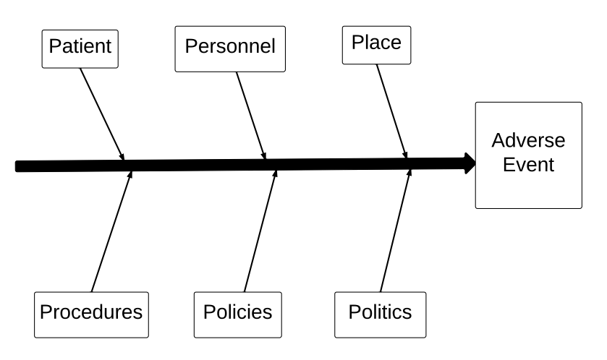
Fishbone Diagram

Slide 29
Fishbone Diagram

Slide 30
Group Activity 4 Apply ACGME competencies to the problems identified
ACGME competency | Yes | No | Describe
Medical Knowledge | X
Patient care provided | X
Communication & Interpersonal skills | X |  | Communication within & between teams
Professionalism | X |  | Accountability; ownership of system outcomes.
Practice-based learning & Improvement | X |  | Appraise Lit; SWOT, QI
Systems-based practice | X |  | Identify errors; TEAMS, quality care, safety

Slide 31
Literature Review
Trainee
Notes:
RELEVANT ARTICLE IF APPLICABLE

Slide 32
Group Activity 5 Action Plan
How do we prevent this from happening again?
Moderator

Slide 33
Ranking the Effectiveness of Error Reduction Strategies
Most Effective (Strong)
Physical Plant Changes
Forcing functions and constraints
Simplifying processes and removing unnecessary steps
Standardization of equipment
Increase in staffing/decrease in workload
Automation and computerization
Checklists and cognitive aids
Eliminate/reduce distractions
Read back
Eliminate redundancy
Warnings
Development of new policies
Training
Double checks
Least Effective (Weak )
Gosbee JW, Gosbee LL, eds. Human Factors Engineering to Improve Patient Safety. Oakbrook IL: Joint Commission Resources 2005

Slide 34
Take Home Points

Slide 35
References

Slide 36
Thank You!
Questions?

